Slide 1
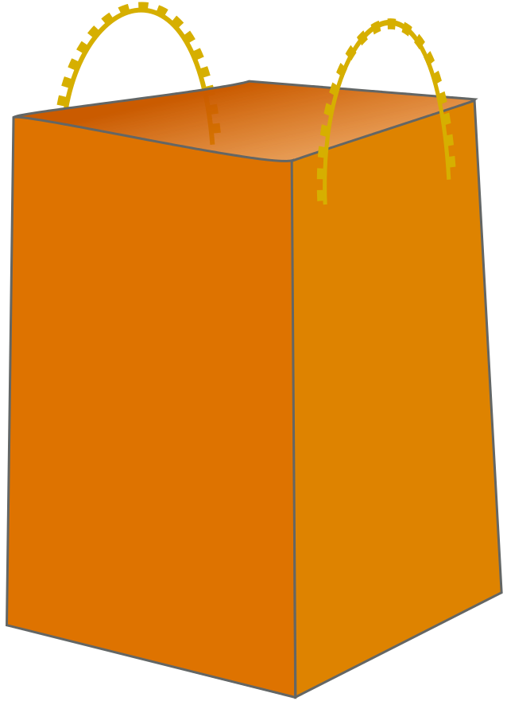
34
3.45
x
z
!!! Say Cheese 2 times !!!
y

